Slide 1
Progress Meeting 11/05/2020

Slide 2
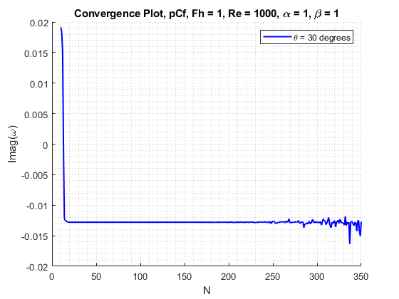
Convergence

Slide 3
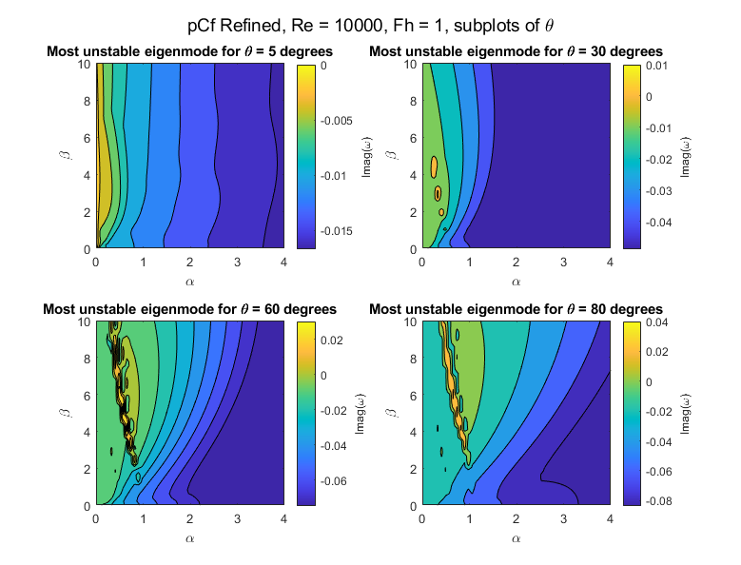
α,β sweep – plane Couette flow

Slide 4
Remarks
As tilt angle increases, this destabilises base flow
Flow only unstable for small values of α
Reproduce plots with a smaller range for α
For a certain value of α, β has small influence on shear stability
Pocket of instability found for α ~ 1 and β ~ 5
Produce plots for small range around these wavenumbers

Slide 5
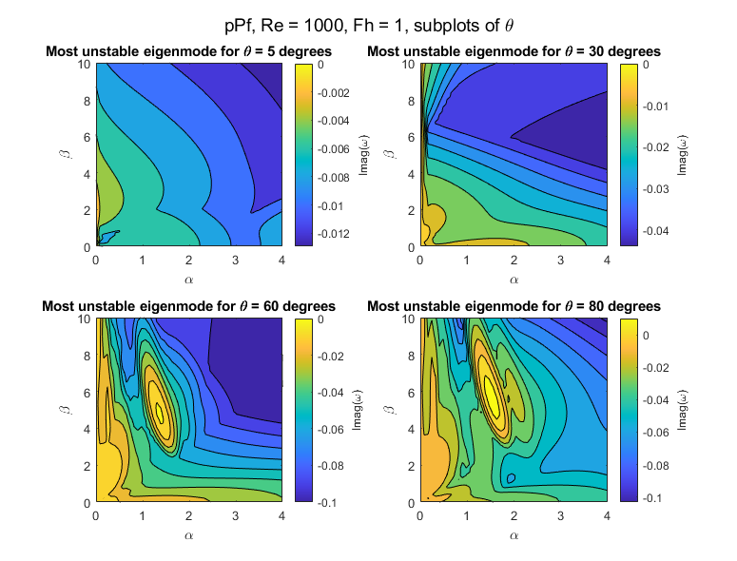
α,β sweep – plane Poiseuille flow

Slide 6
Remarks
As tilt angle increases, this destabilises base flow
Flow only unstable for small values of α
Reproduce plots with a smaller range for α
For a certain value of α, β has larger influence on shear stability
Pocket of instability found for α ~ 2 and β ~ 6
Produce plots for small range around these wavenumbers

Slide 7
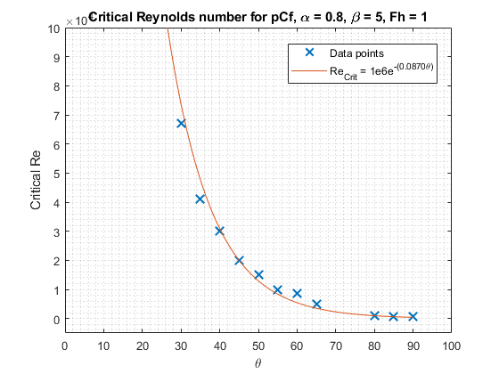
Critical Re – plane Couette flow

Slide 8
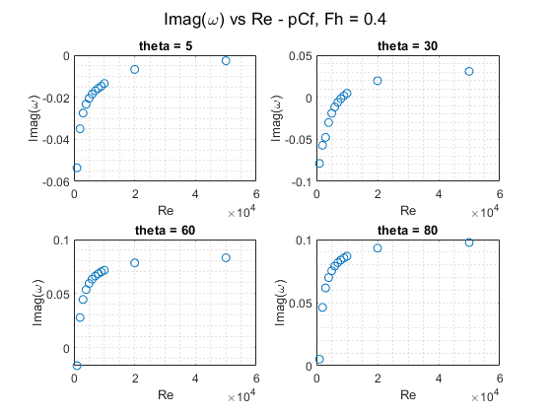
Imag(omega) vs Re – plane Couette flow

Slide 9
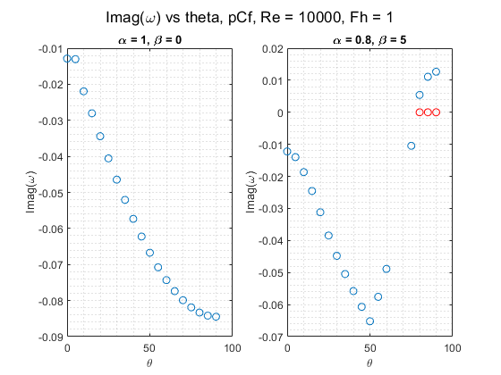
Imag(omega) vs theta – Couette flow

Slide 10
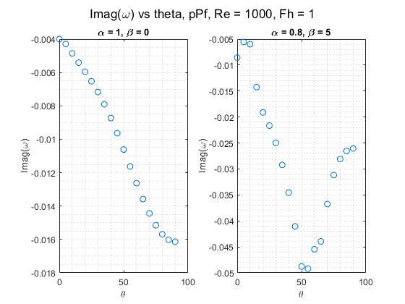
Imag(omega) vs theta – Poiseuille flow

Slide 11
Plans for next week
Critical Re versus theta for pPf
Imag(Omega) versus Re for pPf
Investigate Fh influence

